Slide 1

IT8302 Applied Machine Learning CA2
Sng Tian Hao, Keith
1273381F
18 February 2025

Slide 2
Wine Clustering
Clustering of wine dataset from UCI

Slide 3

Overview
In this analysis, we used the UCI Wine dataset to cluster different groups of wines based on their chemical properties without predefined labels
Models evaluated in this analysis include:
K-Means
DBSCAN
Gaussian Mixture Model
Agglomerative Clustering
The models were then evaluated for optimal cluster count and compared using multiple evaluation metrics

Slide 4
Modelling Approach
EDA
Data Pre-Processing
Cluster Modelling
Examine dataset, inspect column data types
Check if there are any missing values
Get descriptive statistics of each column to determine if scaling is required
Data is standardised using Standard Scaler to ensure consistent feature scaling
Scaling necessary as clustering algorithms using Euclidean distance are sensitive to scale differences
Reshape actual labels to numpy array for cluster validation
Hyperparameter tuning applied to optimise each clustering model
Various metrics (e.g., inertia, BIC, silhouette coefficient, etc.) used to determine the best hyperparameters
After tuning, models are compared using the following metrics to identify the best-performing clustering approach for dataset:
Silhouette Coefficient
Davies-Bouldin Score
Adjusted Mutual Information Score
Fowlkes-Mallows Score

Slide 5
Baseline

Slide 6
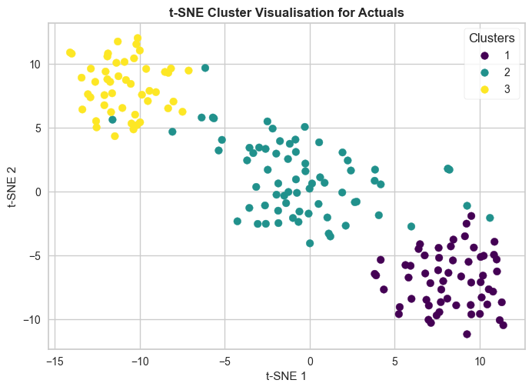
Evaluation of Actual Labels
Applied t-SNE to reduce feature dimensions from 13 to 2 to facilitate visualisation of wine dataset clusters and analysis of underlying groupings
Evaluated clustering of wine dataset using actual labels to serve as baseline for model development
Metric | Score
Silhouette Coefficient | 0.28
Davies-Bouldin Score | 1.41
Adjusted Mutual Information Score | 1
Fowlkes-Mallows Score | 1

Slide 7
KMeans Clustering

Slide 8
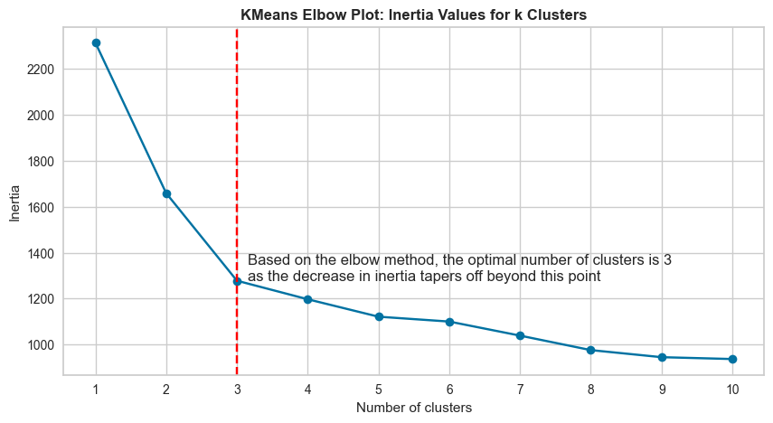
KMeans Elbow Plot
The true number of clusters is unknown, so we assess different values of clusters to find the optimal number
Elbow method used with inertias (sum of squared distances to cluster centroids) to evaluate the KMeans model
Cluster size of 3 determined to be the best, proceeded with this value for model development

Slide 9
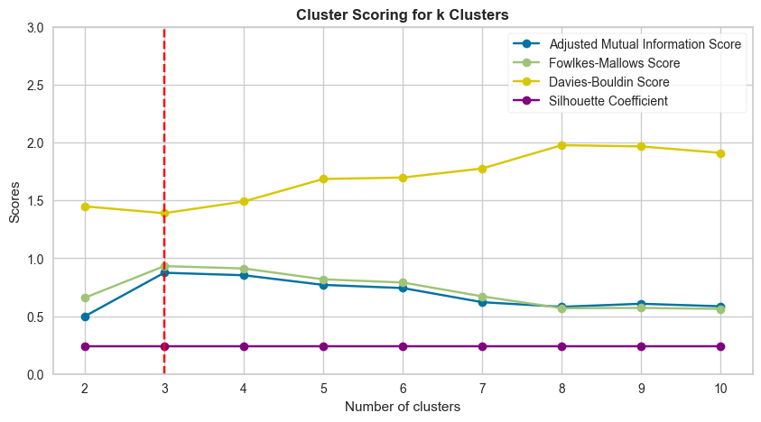
KMeans Model Tuning
Evaluation metrics (Silhouette Coefficient, Davies-Bouldin, AMI, and Fowlkes-Mallows) align with conclusion on number of clusters from elbow plot
Silhouette coefficient, AMI, and FM scores are highest at 3 clusters, while Davies-Bouldin score is lowest at the same value
Hyperparameter setting can be applied to future data, assuming the number of wine types remains unchanged

Slide 10
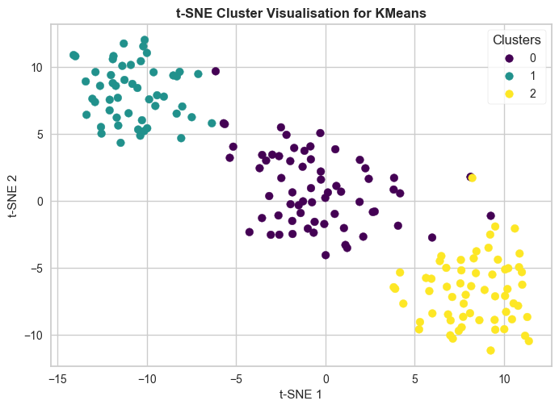
KMeans Model Evaluation
Model evaluated using n_clusters=3
Clustering appear relatively well separated and compact
Scores are close to baseline, indicating reliable and consistent clustering
Metric | Score
Silhouette Coefficient | 0.29
Davies-Bouldin Score | 1.39
Adjusted Mutual Information Score | 0.89
Fowlkes-Mallows Score | 0.94

Slide 11
DBSCAN

Slide 12
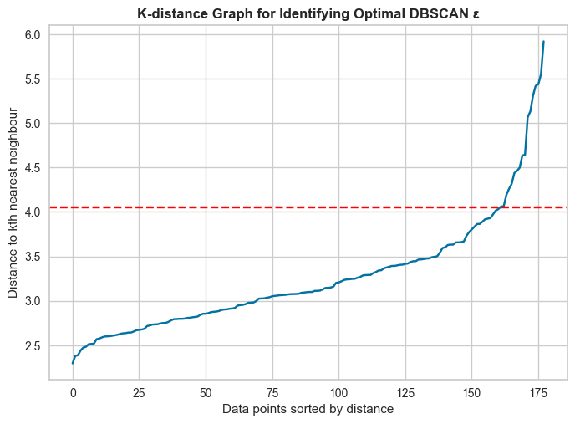
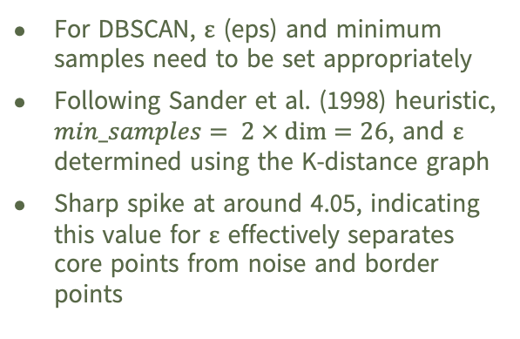
K-Distance Graph for DBSCAN
For DBSCAN, ε (eps) and minimum samples need to be set appropriately
Following Sander et al. (1998) heuristic, $min_samples= 2 × dim=26$, and ε determined using the K-distance graph
Sharp spike at around 4.05, indicating this value for ε effectively separates core points from noise and border points
Sander, J., Ester, M., Kriegel, H.-P., & Xu, X. (1998). Density-based clustering in spatial databases: The algorithm GDBSCAN and its applications. Data Mining and Knowledge Discovery, 2(2), 169–194.

Slide 13
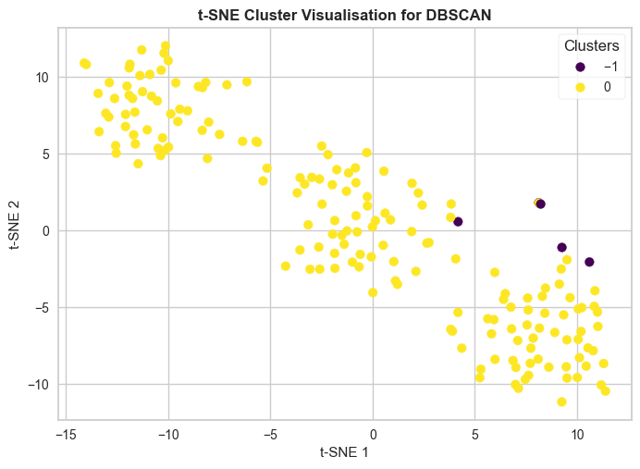
DBSCAN Model Evaluation
Hyperparameters are set to min_samples=26 and ε=4.05 for DBSCAN
The model identifies only 1 cluster, with -1 representing noisy data points
Poor identification of clusters, indicating DBSCAN may not be suitable for this dataset
Metric | Score
Silhouette Coefficient | 0.26
Davies-Bouldin Score | 1.86
Adjusted Mutual Information Score | 0.03
Fowlkes-Mallows Score | 0.56

Slide 14
Gaussian Mixture Model (GMM)

Slide 15
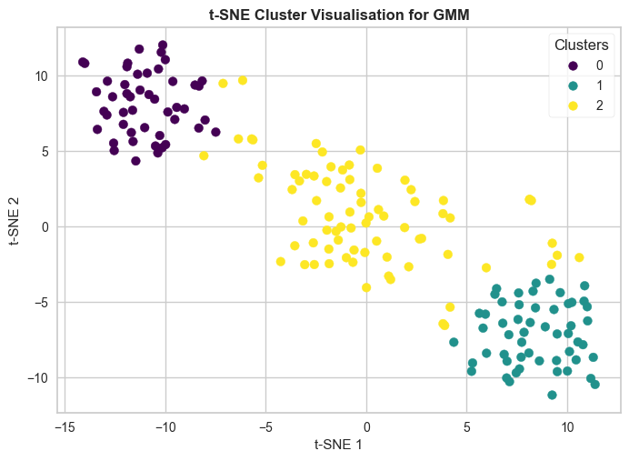
GMM Model Tuning & Evaluation
GridSearchCV used to find the best-performing model, optimising based on BIC
Best parameters are covariance_type=”spherical” and n_components=3
Results are similar to baseline and KMeans, making it a strong alternative
Metric | Score
Silhouette Coefficient | 0.27
Davies-Bouldin Score | 1.41
Adjusted Mutual Information Score | 0.85
Fowlkes-Mallows Score | 0.92

Slide 16
Agglomerative Clustering

Slide 17
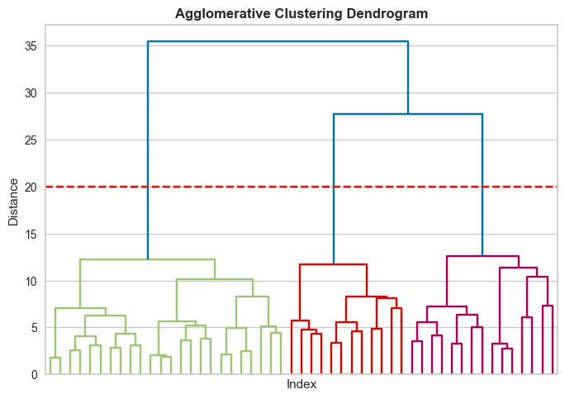
Agg. Clustering Model Tuning
Tuned hyperparameters for number of clusters and linkage criterion using multiple evaluation metrics
linkage=“ward” with n_clusters=3 proved to be the best combination
Plotted dendrogram to visualise the clusters and support findings
Identified the optimal cut-off by observing the largest vertical gap between nodes and the horizontal line, which passes across 3 branches

Slide 18
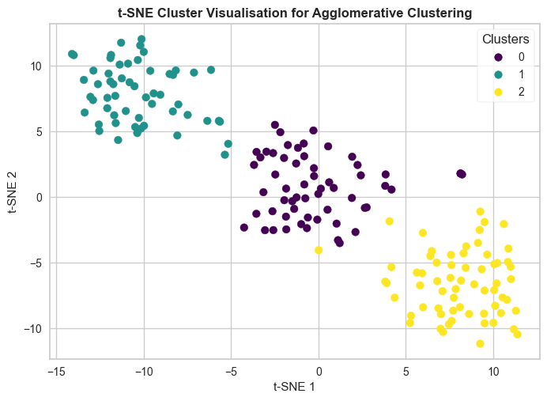
Agg. Clustering Model Evaluation
Results comparable to baseline and KMeans as the clusters are compact and spherical
Clusters of Agg. Clustering, GMM and KMeans may converge due to the nature of the clusters
Metric | Score
Silhouette Coefficient | 0.28
Davies-Bouldin Score | 1.42
Adjusted Mutual Information Score | 0.78
Fowlkes-Mallows Score | 0.86

Slide 19
Conclusion

Slide 20
Clustering Result Summary
We recommend using 3 clusters/components with KMeans, GMM, or Agg. Clustering
For larger datasets, KMeans is preferred due to its computational efficiency
Metric | KMeans | DBSCAN | GMM | Agg. Clustering | Actual Labels
Silhouette Coefficient | 0.29 | 0.26 | 0.27 | 0.28 | 0.28
Davies-Bouldin Score | 1.39 | 1.86 | 1.41 | 1.42 | 1.41
Adjusted Mutual Information Score | 0.89 | 0.03 | 0.85 | 0.78 | 1
Fowlkes-Mallows Score | 0.94 | 0.56 | 0.92 | 0.86 | 1

Slide 21
Stock Price Forecasting
Forecasting the stock price of Apple, Amazon, and DBS for the next 60 days

Slide 22

Overview
Time series modelling is a powerful tool for analysing temporal data and generating future predictions
While forecasts may not always be entirely accurate, they offer valuable insights into potential trends and help anticipate future movements
In this analysis, we apply time series methods such as Holt-Winters Exponential Smoothing (HWES) and Seasonal ARIMA (SARIMA) modelling to predict the stock prices of Apple, Amazon, and DBS over the next 60 days

Slide 23
Modelling Approach
EDA
Analysis Prep
Model Stock Price
Examine dataset, inspect column data types
Determine frequency of dataset and if there are any missing values
Visualise time series trend
Create functions to facilitate time series analysis and modelling:
Calculate log of stock price
Custom Augment Dickey-Fuller test
Plot seasonal decomposition of time series
Plot ACF & PACF
Time series train-test-split
Train & evaluate SARIMA model
Train & evaluate HWES model
SARIMA 60-day forecast
HWES 60-day forecast
Calculate log of stock price and determine stationarity of time series
Decompose time series determine if any seasonality
Plot ACF & PACF plots to determine if any MA and AR components
Train and evaluate both HWES & ARIMA models using seasonality, AR, and MA values informed by prior analyses
After tuning models, forecast stock price for next 60 days

Slide 24
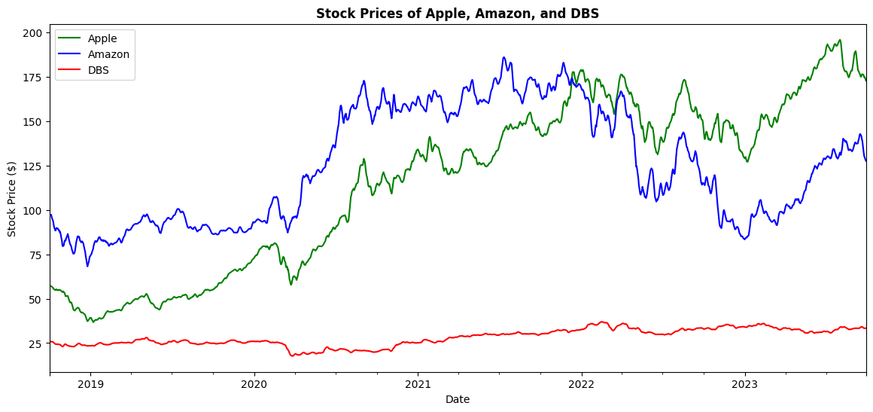
Exploratory Data Analysis
Plotted 5-day Simple Moving Average (SMA5)
Stock prices of major multinationals (e.g., Apple, Amazon) fluctuate more than local firms like DBS
Apple and Amazon show a clearer upward trend, while DBS’s growth is less apparent
Time series appear non-stationary and seasonality requires further analysis

Slide 25
Apple Stock

Slide 26
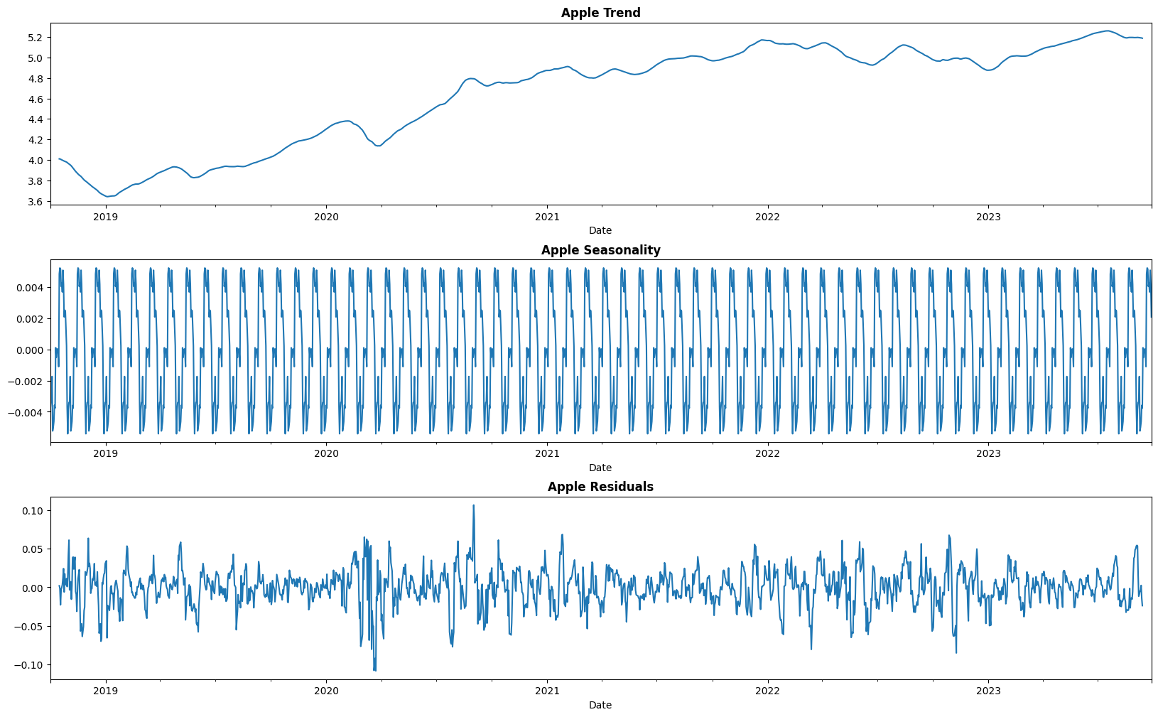
Seasonal Decomposition
Aim is to select a seasonal decomposition period that smooths the trend while ensuring efficient modelling
A large period increases computation time whereas a small period may miss key seasonal patterns
Based on decomposition plot, a seasonal period of 30 days appears sufficient for our model

Slide 27
Augmented Dickey-Fuller Test
Stationarity test for different Apple time series
Time Series | Differentiation Parameter Value | Stationarity
Logged Apple Time Series | d = 0 | Not stationary (p > 0.05)
1st Differenced Logged Apple Time Series | d = 1 | Stationary
1st Differenced & 1st Seasonally Differenced Logged Apple Time Series | d = 1 D = 1 | Stationary

Slide 28
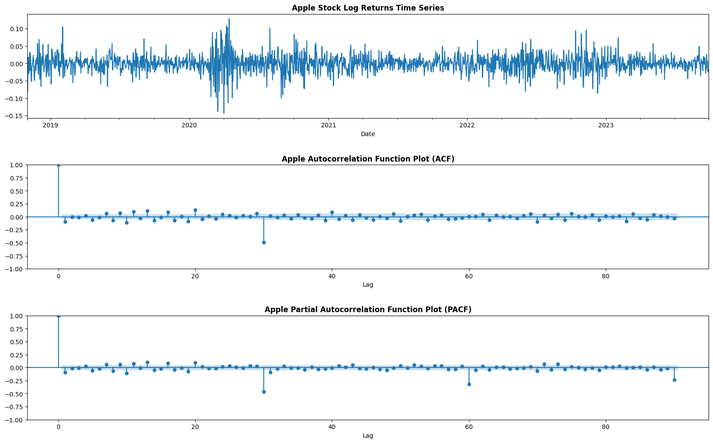
ACF & PACF Plots
We analysed 1st differenced and 1st seasonally differenced data (seasonal period = 30) to identify correlations at specific lags
ACF and PACF plots help determine suitable values for p and q
Spikes at p = 1, q = 1, and intervals of 30 suggest P = 2 and Q = 1
These values will be used for further analysis

Slide 29
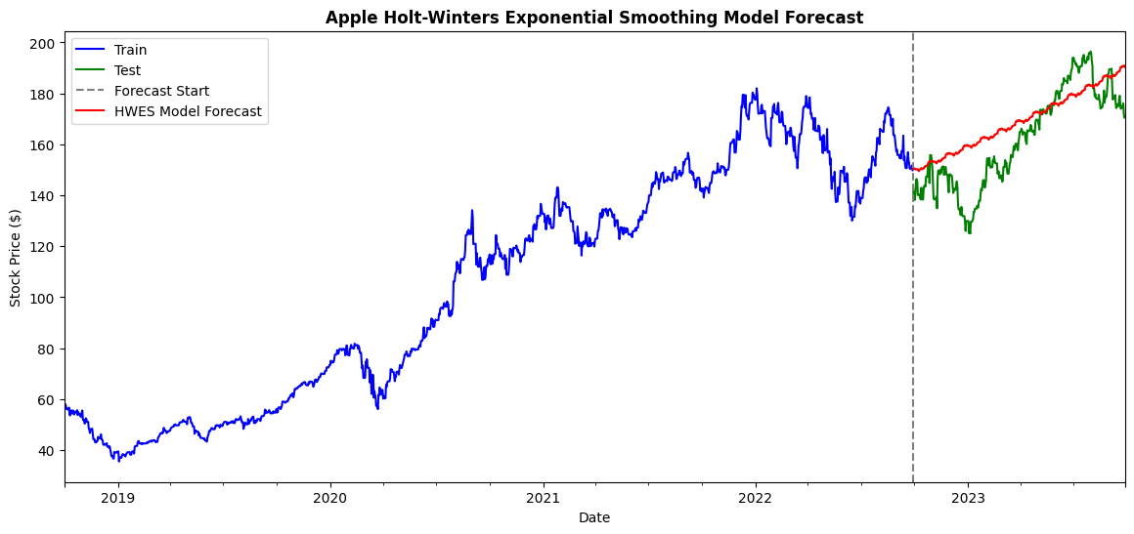
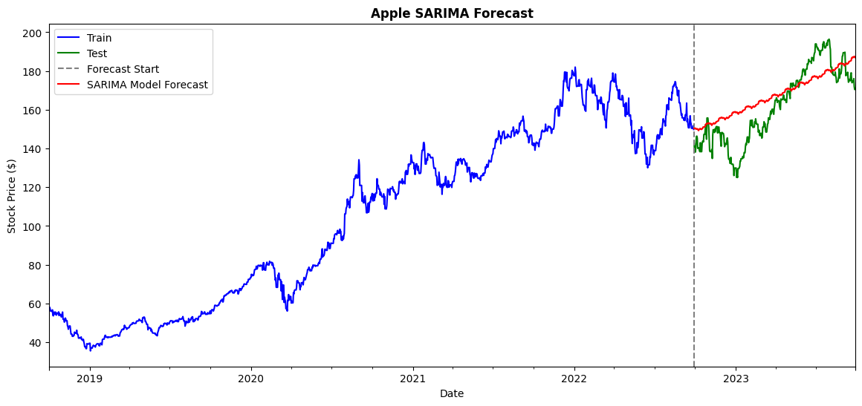
HWES & SARIMA Model Evaluation
The logged Apple time series was split 80-20 for training and evaluation
HWES model developed with seasonal_periods=30 and SARIMA with order=(1,1,1) and seasonal_order=(2,1,1,30)
HWES achieved a MAPE of 7.00%, while SARIMA had a lower MAPE of 6.70%
Both models captured the upward trend well, with SARIMA providing slightly more accurate predictions

Slide 30
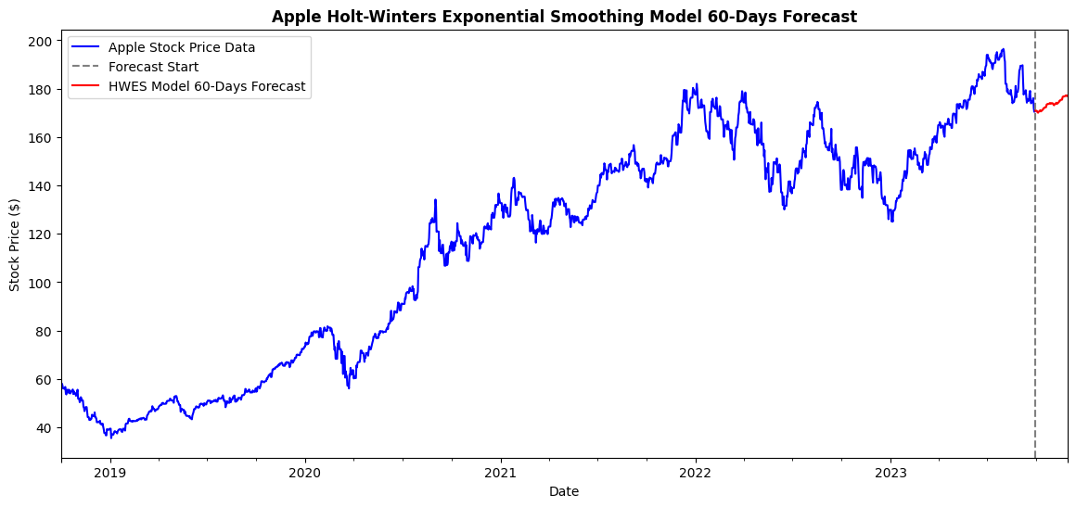
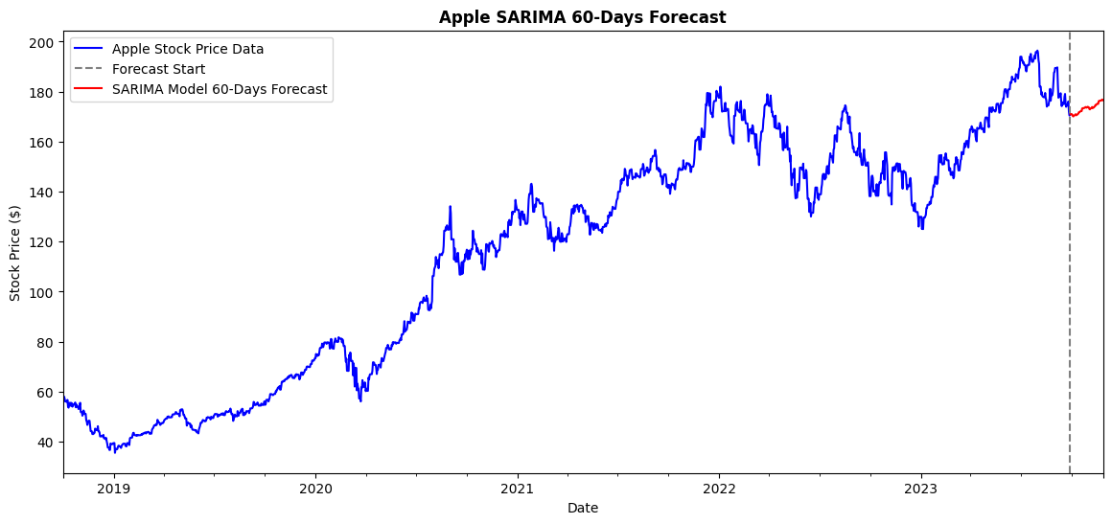
HWES & SARIMA 60-Day Forecast
Both HWES and SARIMA both capture a similar upward trend prediction for the next 60 days

Slide 31
Amazon Stock

Slide 32
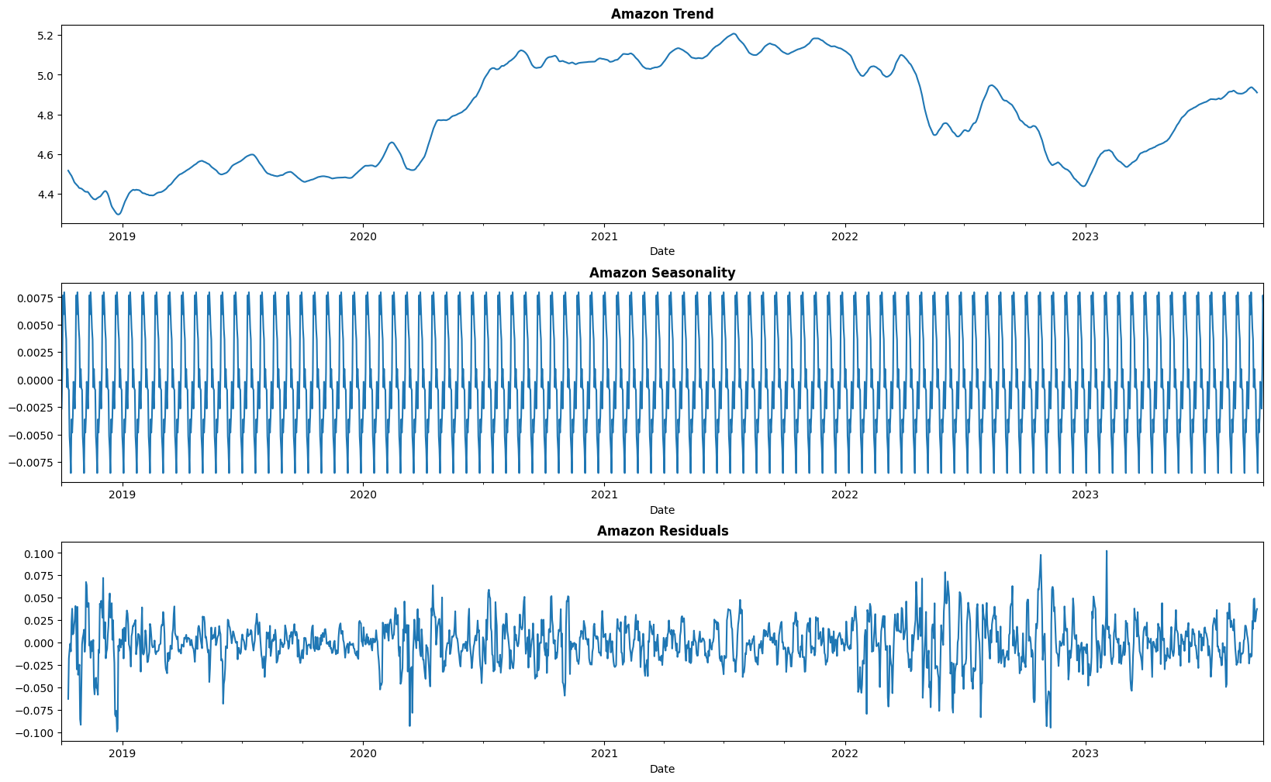
Seasonal Decomposition
Aim is to select a seasonal decomposition period that smooths the trend while ensuring efficient modelling
A large period increases computation time whereas a small period may miss key seasonal patterns
Based on decomposition plot, a seasonal period of 20 days appears sufficient for our model

Slide 33
Augmented Dickey-Fuller Test
Stationarity test for different Amazon time series
Time Series | Differentiation Parameter Value | Stationarity
Logged Amazon Time Series | d = 0 | Not stationary (p > 0.05)
1st Differenced Logged Amazon Time Series | d = 1 | Stationary
1st Differenced & 1st Seasonally Differenced Logged Amazon Time Series | d = 1 D = 1 | Stationary

Slide 34
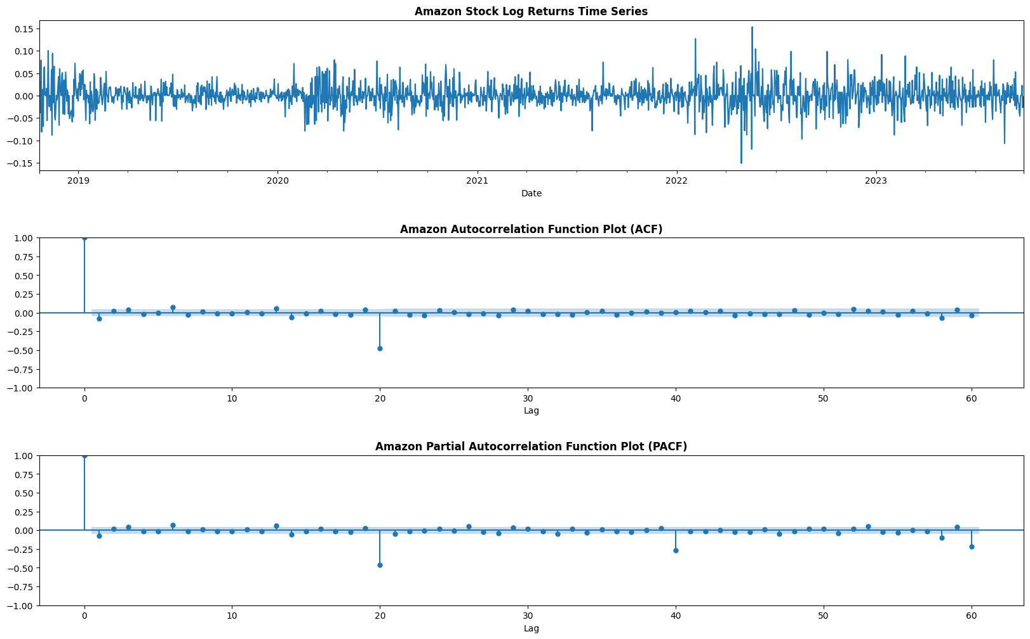
ACF & PACF Plots
We analysed 1st differenced and 1st seasonally differenced data (seasonal period = 20) to identify correlations at specific lags
ACF and PACF plots help determine suitable values for p and q
Spikes at p = 1, q = 1, and intervals of 20 suggest P = 2 and Q = 1
These values will be used for further analysis

Slide 35
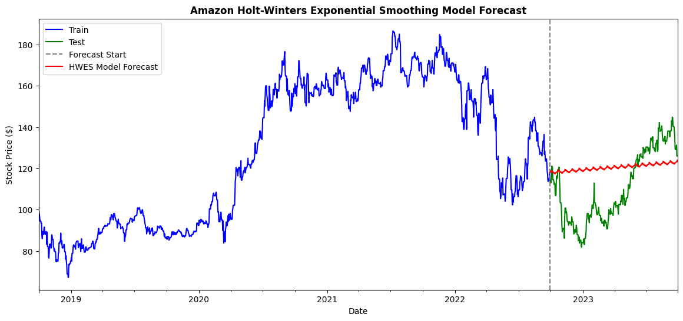
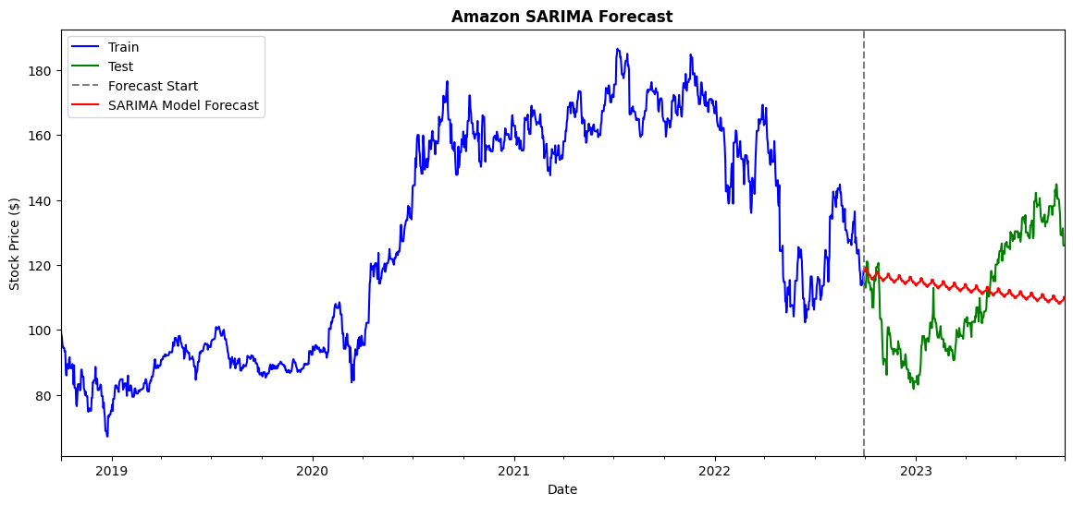
HWES & SARIMA Model Evaluation
The logged Amazon time series was split 80-20 for training and evaluation
HWES model developed with seasonal_periods=20 and SARIMA with order=(1,1,1) and seasonal_order=(2,1,1,20)
HWES achieved a MAPE of 16.20%, while SARIMA performed slightly better with a MAPE of 16.02%
HWES captured the upward trend well, while SARIMA better captured the downward trend
Regardless, the lower MAPE suggests SARIMA provided slightly more accurate forecasts

Slide 36
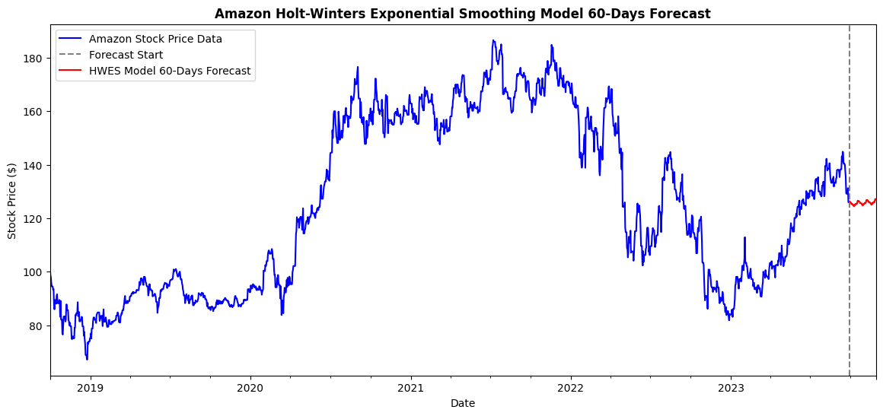
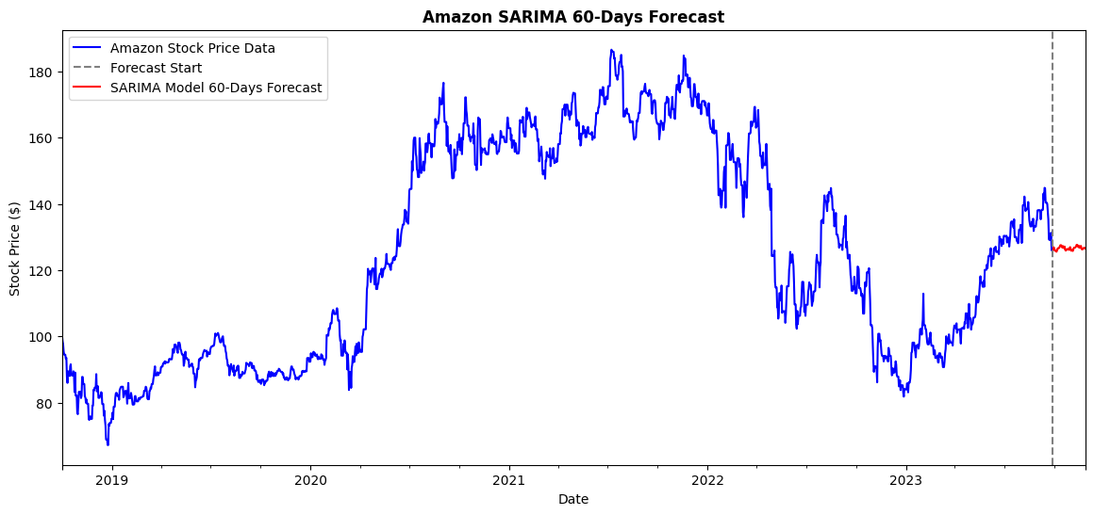
HWES & SARIMA 60-Day Forecast
HWES captures more of the upward trend, while SARIMA focuses more on the downward trend in the 60-day forecast

Slide 37
DBS Stock

Slide 38
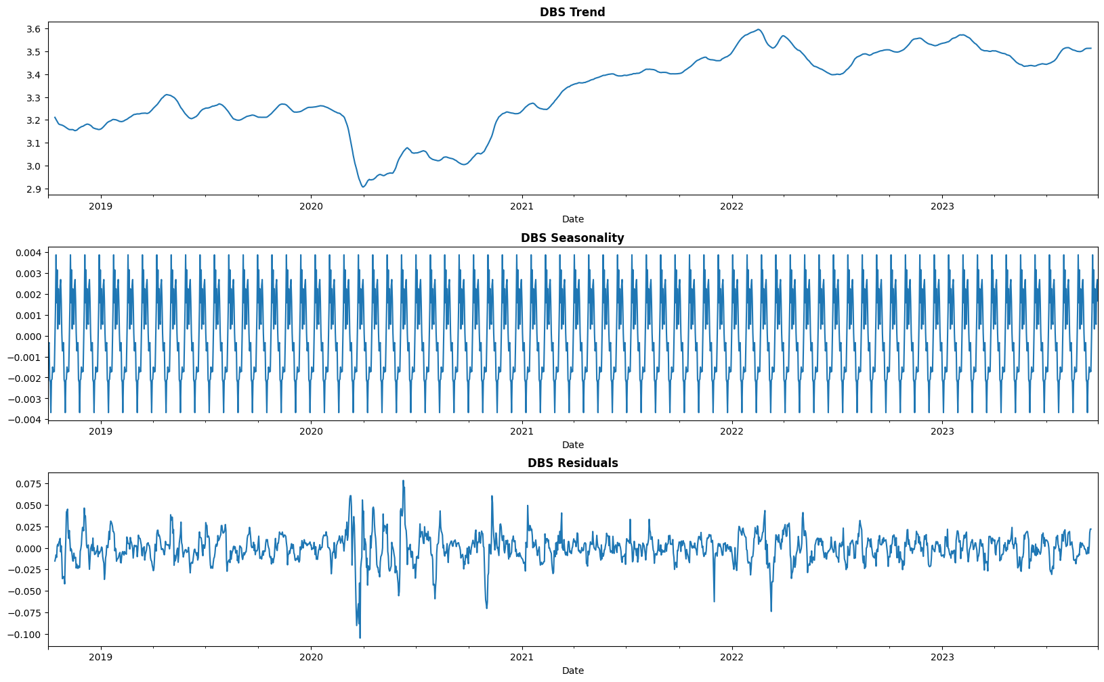
Seasonal Decomposition
Aim is to select a seasonal decomposition period that smooths the trend while ensuring efficient modelling
A large period increases computation time whereas a small period may miss key seasonal patterns
Based on decomposition plot, a seasonal period of 25 days appears sufficient for our model

Slide 39
Augmented Dickey-Fuller Test
Stationarity test for different DBS time series
Time Series | Differentiation Parameter Value | Stationarity
Logged DBS Time Series | d = 0 | Not stationary (p > 0.05)
1st Differenced Logged DBS Time Series | d = 1 | Stationary
1st Differenced & 1st Seasonally Differenced Logged DBS Time Series | d = 1 D = 1 | Stationary

Slide 40
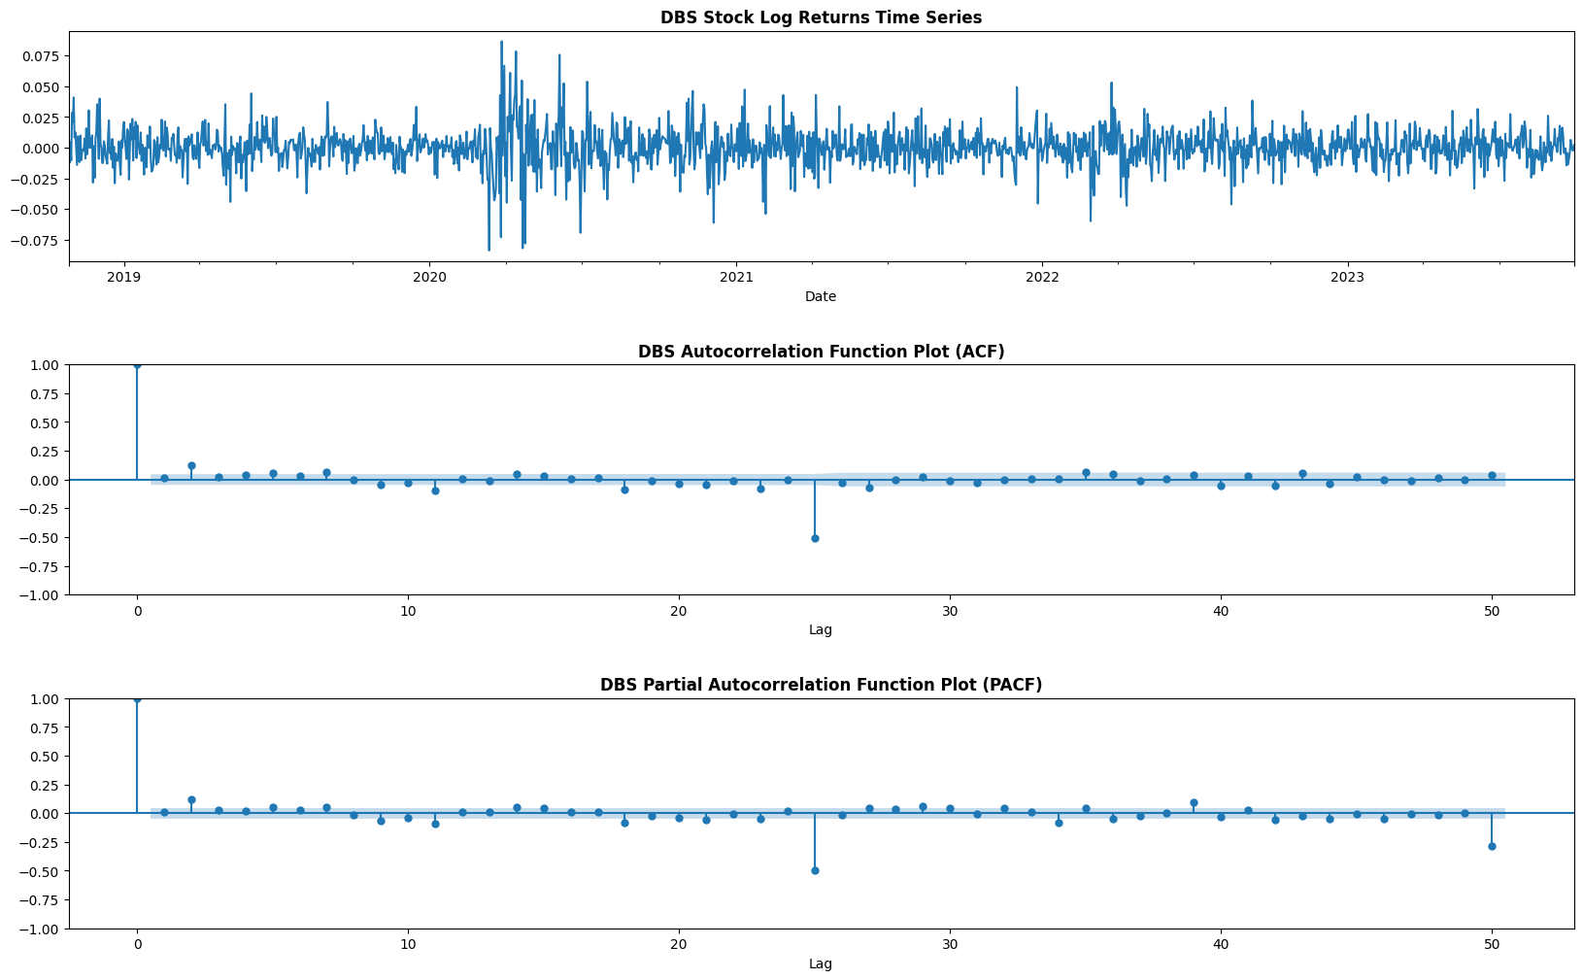
ACF & PACF Plots
We analysed 1st differenced and 1st seasonally differenced data (seasonal period = 25) to identify correlations at specific lags
ACF and PACF plots help determine suitable values for p and q
Spikes at p = 2, q = 2, and intervals of 25 suggest P = 2 and Q = 1
These values will be used for further analysis

Slide 41
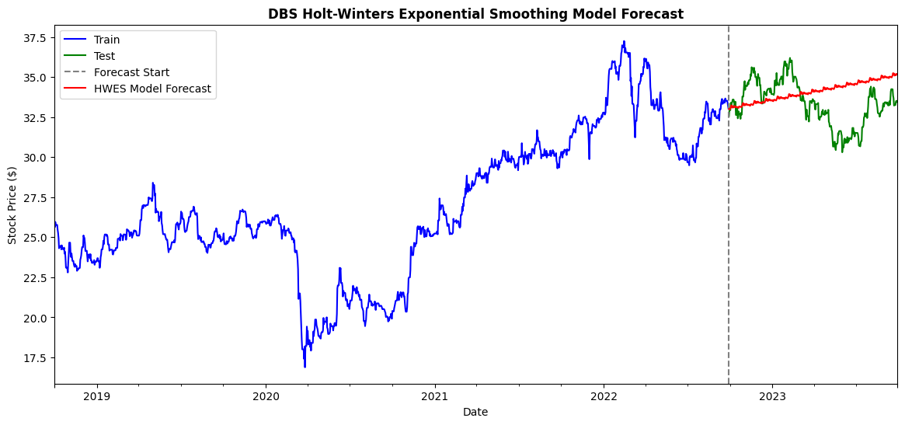
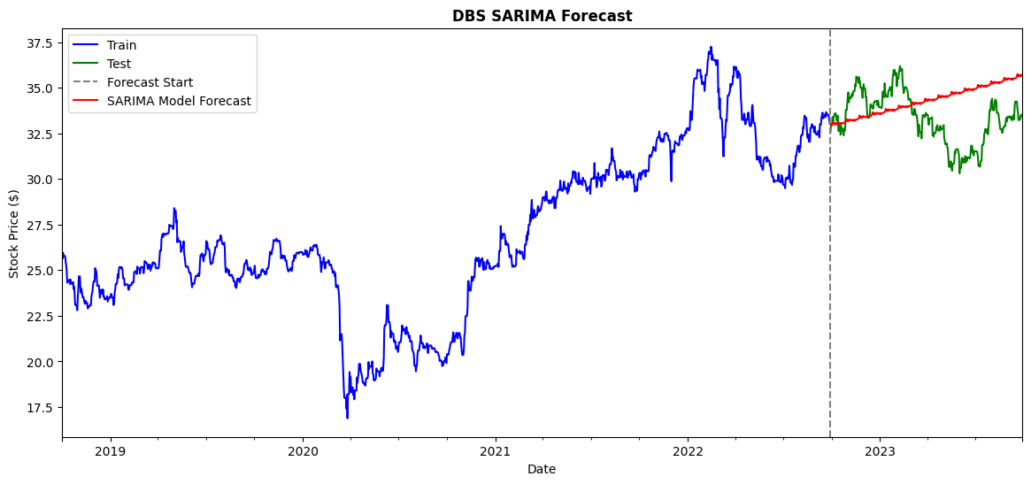
HWES & SARIMA Model Evaluation
The logged DBS time series was split 80-20 for training
HWES model developed with seasonal_periods=25 and SARIMA with order=(2,1,2) and seasonal_order=(1,1,1,25)
Despite the PACF plot suggesting P = 2, using P = 1 resulted in a lower AICc and MAPE, so we proceeded with this value
Both models aligned with the overall upward trend
HWES achieved a lower MAPE (4.86%) than SARIMA (5.42%), indicating better predictive accuracy for DBS

Slide 42
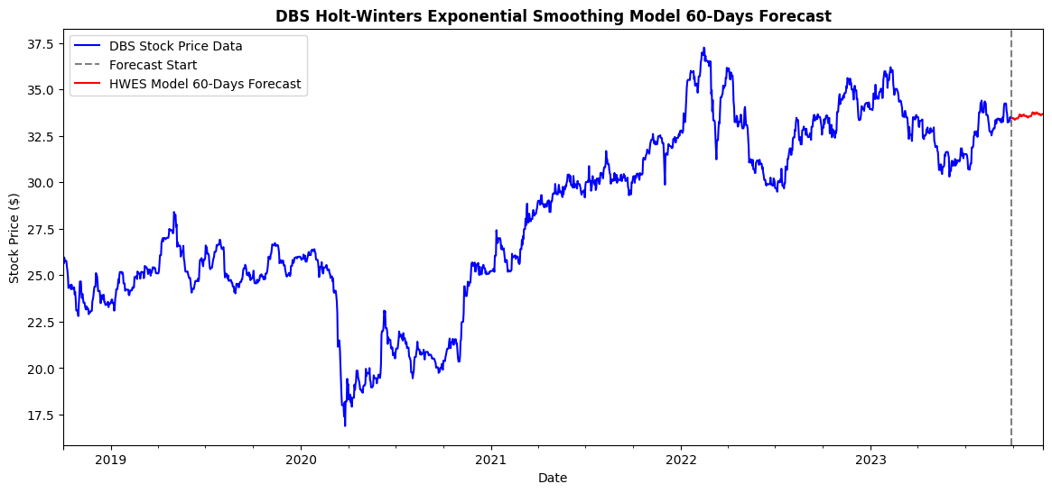
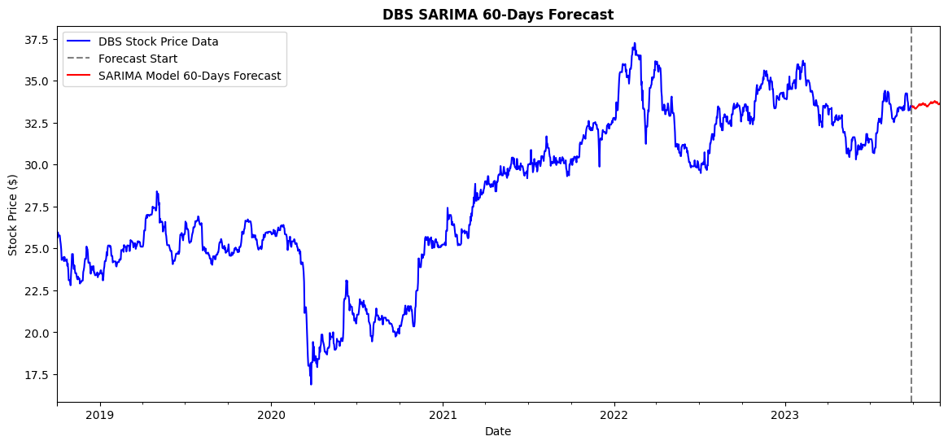
HWES & SARIMA 60-Day Forecast
Both HWES and SARIMA both have a similar upward trend prediction for the next 60 days

Slide 43
END
Thank you!

